Slide 1
UNIT 5 DATA FLOW TESTING

Slide 2
Definition- Data Flow Testing
Data flow testing refers to forms of structural testing that focus
on the points at which variables receive values and the points at which these values are used (or referenced).
Data flow testing serves as a “reality check” on path testing
Two mainline forms of data flow testing: one provides a set of basic definitions and a unifying structure of test coverage metrics, while the other is based on a concept called a “program slice.”
While dataflow and slice-based testing are cumbersome at the unit level; they are well suited for object-oriented code.

Slide 3
Theoretical Background
Most programs deliver functionality in terms of data.
Variables that represent data somehow receive values, and these values are used to compute values for other variables.
Early data flow analyses often centered on a set of faults that are now known as define/reference anomalies:
A variable that is defined but never used (referenced)
A variable that is used before it is defined
A variable that is defined twice before it is used
Anomalies can be discovered by what is known as static analysis: finding faults in source code without executing it.

Slide 4
Define/Use Testing
The following definitions refer to a program P that has a program graph G(P) and a set of program variables V. The program graph G(P) is constructed as in Chapter 4, with statement fragments as nodes and edges that represent node sequences. G(P) has a single-entry node and a single-exit node.
Definition (Defining node)
Node n ∈ G(P) is a defining node of the variable v ∈ V, written as DEF(v, n), if and only if the value of variable v is defined as the statement fragment corresponding to node n.
Input statements, assignment statements, loop control statements, and procedure calls are all examples of statements that are defining nodes. When the code corresponding to such statements executes, the contents of the memory location(s) associated with the variables are changed.
Definition (usage node)
Node n ∈ G(P) is a usage node of the variable v ∈ V, written as USE(v, n), if and only if the value
of the variable v is used as the statement fragment corresponding to node n.
Output statements, assignment statements, conditional statements, loop control statements, and procedure calls are all examples of statements that are usage nodes. When the code corresponding to such statements executes, the contents of the memory location(s) associated with the variables remain unchanged.

Slide 5
Define/Use Testing
Definition (This is P-use)
A usage node USE(v, n) is a predicate use (denoted as P-use) if and only if the statement n is a predicate statement; otherwise, USE(v, n) is a computation use (denoted C-use).
The nodes corresponding to predicate uses always have an outdegree ≥ 2, and nodes corresponding to computation uses always have an outdegree ≤ 1.
Definition (DU paths)
A definition/use path with respect to a variable v (denoted du-path) is a path in PATHS(P) such that, for some v ∈ V, there are define and usage nodes DEF(v, m) and USE(v, n) such that m and n are the initial and final nodes of the path.
Definition
A definition-clear path with respect to a variable v (denoted dc-path) is a definition/use path in PATHS(P) with initial and final nodes DEF(v, m) and USE(v, n) such that no other node in the path is a defining node of v.

Slide 6
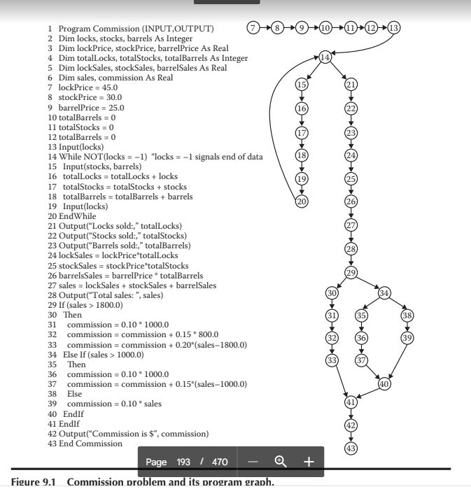
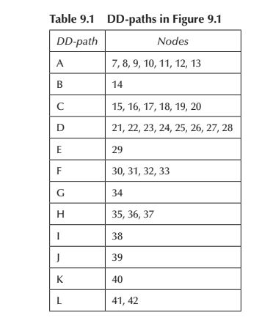
du path

Slide 7
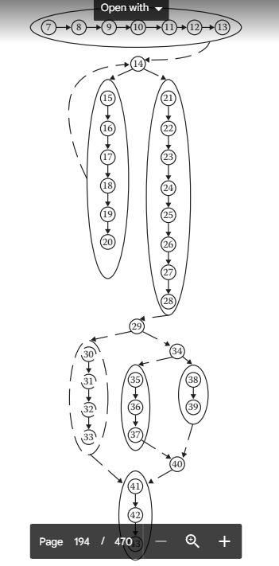
DD path graph

Slide 8
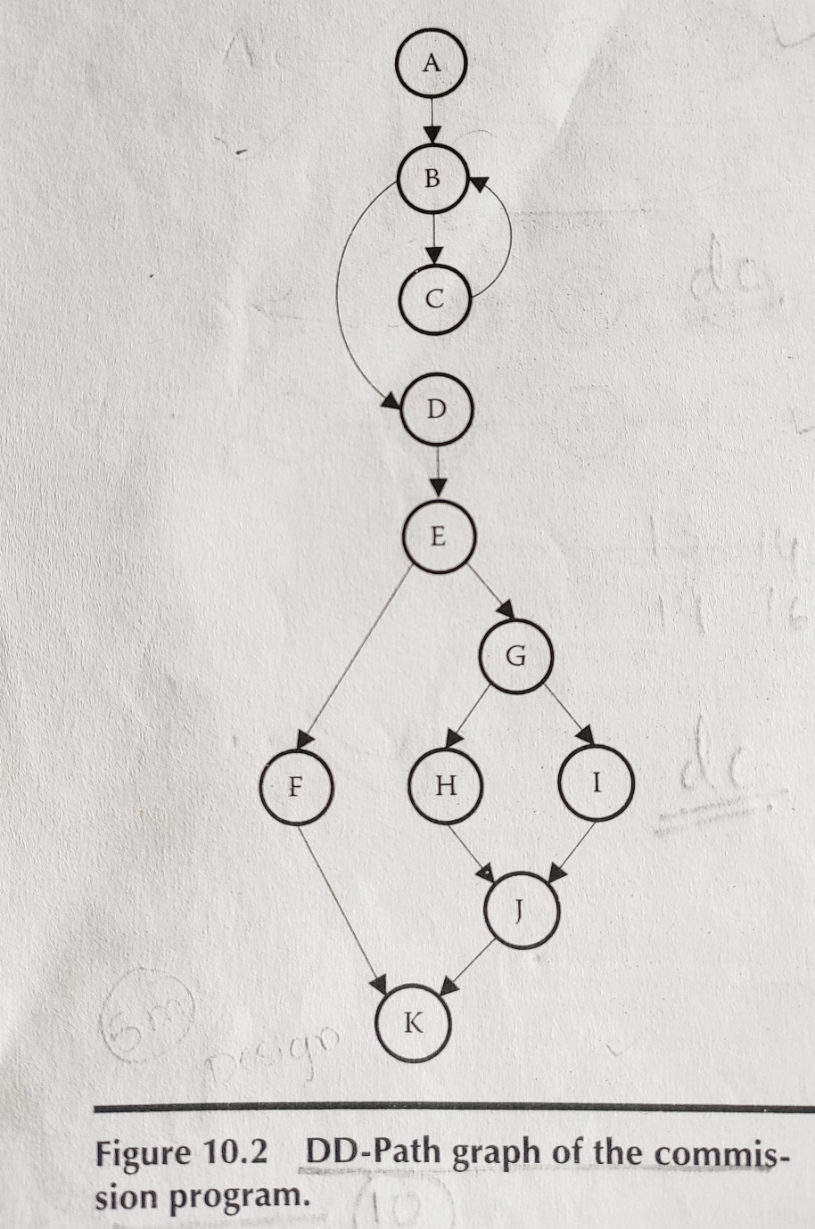
DD path graph for commission problem

Slide 9
Du-paths
Du-paths for Stocks:
We have DEF(stocks, 15) and USE(stocks, 17), so the path <15, 17> is a du-path with respect to stocks.
Du-paths for Locks
Two defining and two usage nodes make the locks variable more interesting: we have DEF(locks, 13), DEF(locks, 19), USE(locks, 14), and USE(locks, 16). These yield four du-paths.
p1 = <13, 14> → Bypass the loop - definition clear
p2 = <13, 14, 15, 16> → Begin the loop - definition clear
p3 = <19, 20, 14> → Exit the loop - definition clear
p4 = <19, 20, 14, 15, 16> → Repeat the loop - definition clear

Slide 10
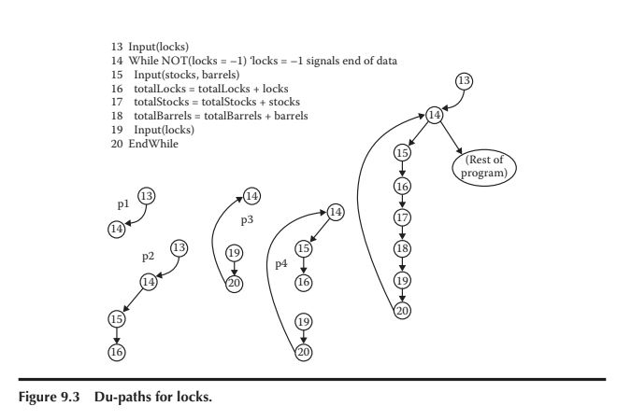
Du-path contd..
Du path for locks

Slide 11
du path contd…
Du Paths for totalLocks
The du-paths for totalLocks will lead us to typical test cases for computations. With two defining nodes (DEF(totalLocks, 10) and DEF(totalLocks, 16)) and three usage nodes (USE(totalLocks, 16), USE(totalLocks, 21), USE(totalLocks, 24)), we might expect six du-paths.
Path P5 : <10,11,12,13,14,15,16> - Enter loop- Definition Clear
Path P6: <10,11,12,13,14,15,16,17,18,19,20,14,21> - Exit loop - Definition not clear
Path P7: <10,11,12,13,14,15,16,17,18,19,20,14,21,22,23,24> -Exit loop- Definition not clear
Path P8:<16,17,18,19,20,14,21> - loop iteration problem – Definition clear
Path P9: <16,17,18,19,20,14,21,22,23,24> - loop iteration problem – Definition clear
Path P10: <16,16> - degenerate – Disallow these du paths

Slide 12
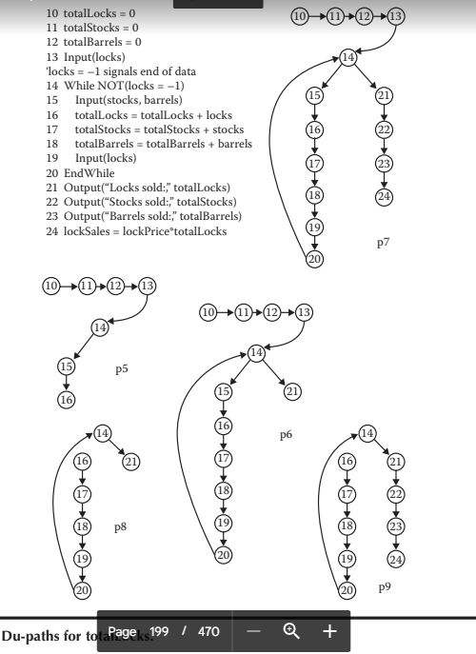
Du path for totallocks

Slide 13
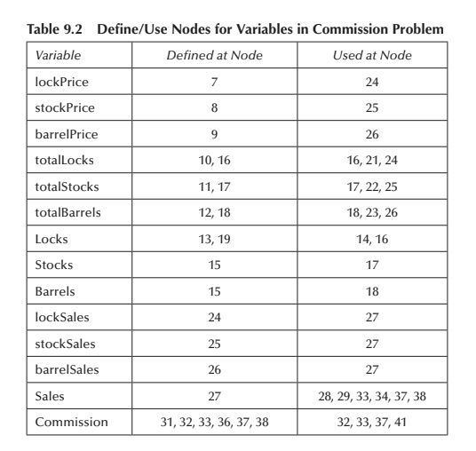
Define/use Nodes

Slide 14
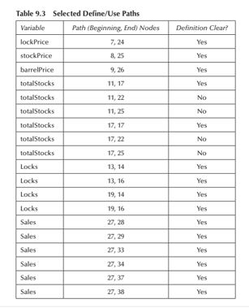
Define/Use Paths

Slide 15
Define/Use Test Coverage Metrics
The whole point of analyzing a program with definition/use paths is to define a set of test coverage metrics known as the Rapps–Weyuker dat
The first three of these are equivalent to three of E.F. Miller’s metrics a flow metrics (Rapps and Weyuker, 1985).
All-Paths, All-Edges, and All-Nodes have been covered here.
The others presume that define and usage nodes have been identified for all program variables, and that du-paths have been identified with respect to each variable.
T is a set of paths in the program graph G(P) of a program P, with the set V of variables.

Slide 16
Define/Use Test Coverage Metrics definition clear paths
Definition (all Definations) The set T satisfies the All-Defs criterion for the program P if and only if for every variable v ∈ V, T contains definition-clear paths from every defining node of v to a use of v
Definition (All uses) The set T satisfies the All-Uses criterion for the program P if and only if for every variable v ∈ V, T contains definition-clear paths from every defining node of v to every use of v, and to the successor node of each USE(v, n).
Definition (All p uses / some c uses) The set T satisfies the All-P-Uses/Some C-Uses criterion for the program P if and only if for every variable v ∈ V, T contains definition-clear paths from every defining node of v to every predicate use of v; and if a definition of v has no P-uses, a definition-clear path leads to at least one computation use.
Definition The set T satisfies the All-C-Uses/Some P-Uses criterion for the program P if and only if for every variable v ∈ V, T contains definition clear paths from every defining node of v to every computation use of v; and if a definition of v has no C-uses, a definition-clear path leads to at least one predicate use.
Definition The set T satisfies the All-DU-paths criterion for the program P if and only if for every variable v ∈ V, T contains definition-clear paths from every defining node of v to every use of v and to the successor node of each USE(v, n), and that these paths are either single loop traversals or they are cycle free.

Slide 17
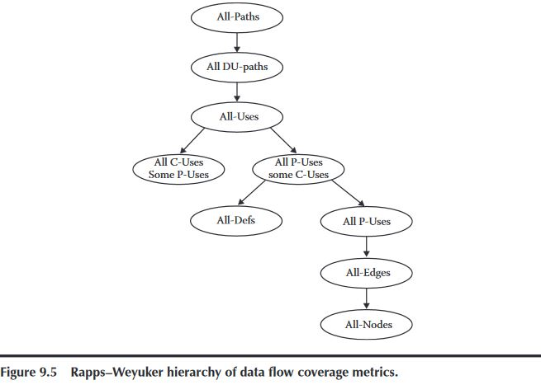
rapps–Weyuker hierarchy of data flow coverage metrics

Slide 18
5 forms of usages
Relationship pertaining to five forms of usages:
P-use used in a predicate (decision) C-use used in computation O-use used for output L-use used for location (pointers, subscripts) I-use iteration (internal counters, loop indices)
Most of the literature on program slices just uses P-uses and C-uses.
Two forms of definition nodes: I-def defined by input A-def defined by assignment

Slide 19
Slice Based Testing
Program slices were proposed in Mark Weiser’s dissertation in 1979.
Given a program P and a set V of variables in P, a slice on the variable set V at statement n, written S(V, n), is the set of all statement fragments in P that contribute to the values of variables in V at node n.
For sets V with more than one variable, we just take the union of all the slices on the individual variables of V.
Slices can be backward or forward slices, and whether they are static or dynamic.
Backward slices refer to statement fragments that contribute to the value of v at statement n.
Forward slices refer to all the program statements that are affected by the value of v and statement n.
In a backward slice S(v, n), statement n is nicely understood as a Use node of the variable v, that is, Use(v, n). Forward slices are not as easily described, but they certainly depend on predicate uses and computation uses of the variable v.
Static backward slice S(v, n) consists of all the statements in a program that determine the value of variable v at statement n, independent of values used in the statements.
Dynamic slices refer to execution time of portions of a static slice with specific values of all variables in S(v, n).

Slide 20
Slice Based Testing
Definition (slice) Given a program P and a set V of variables in P, a slice on the variable set V at statement n, written S(V, n), is the set of all statement fragments in P that contribute to the values of variables in V at node n.
Definition (statemrnt fragments) Given a program P and a program graph G(P) in which statements and statement fragments are numbered, and a set V of variables in P, the static, backward slice on the variable set V at statement fragment n, written S(V, n), is the set of node numbers of all statement fragments in P that contribute to the values of variables in V at statement fragment n.
Advantages of Slicing:
The idea of program slicing is to separate a program into components that have some useful (functional) meaning.
Another refinement is whether or not a program slice is executable.
Adding all the data declaration statements and other syntactically necessary statements clearly increases the size of a slice, but the full version can be compiled and separately executed and tested

Slide 21
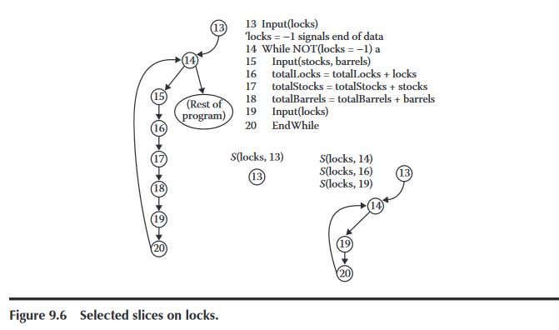
Slice Based Testing

Slide 22
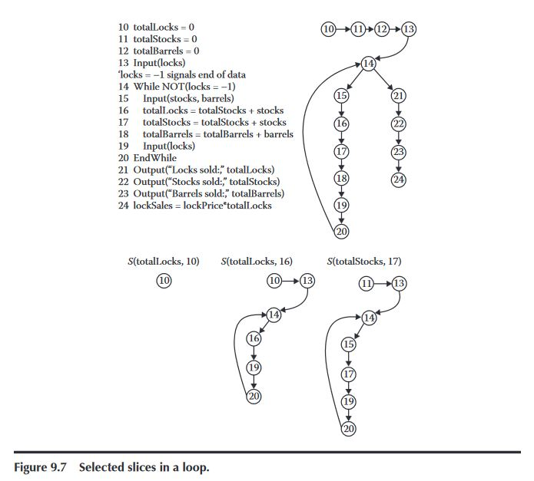
Slice Based Testing

Slide 23
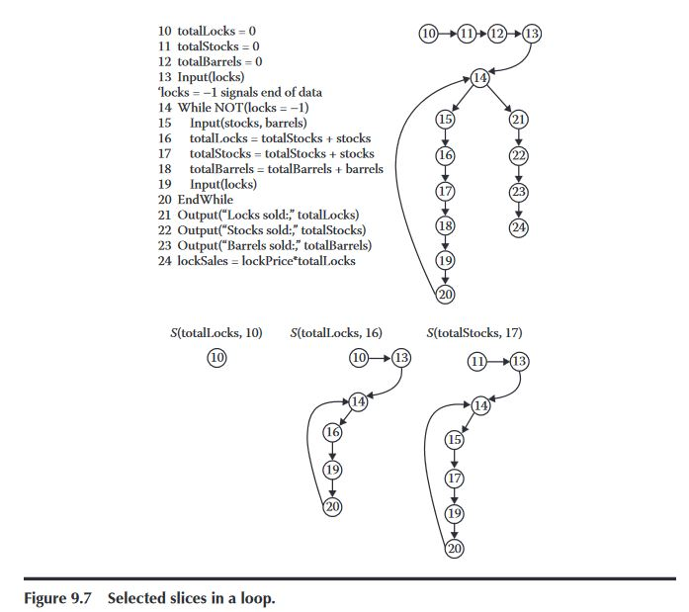
Slice Based Testing

Slide 24
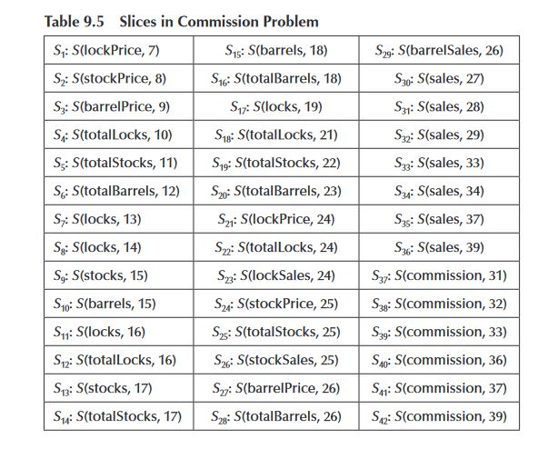
Slice Based Testing
Static Backward Slices and include nodes corresponding to executable statement fragments.

Slide 25
A-def nodes
S1: S(lockPrice, 7) = {7} S2: S(stockPrice, 8) = {8} S3: S(barrelPrice, 9) = {9} S4: S(totalLocks, 10) = {10} S5: S(totalStocks, 11) = {11} S6: S(totalBarrels, 12) = {12}

Slide 26
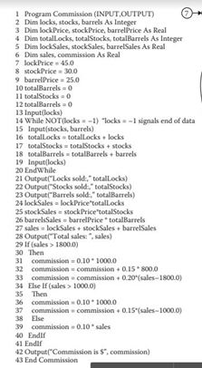
Program Slices Examples
A Slice on Locks
A-def nodes
S1: S(lockPrice, 7) = {7} S2: S(stockPrice, 8) = {8} S3: S(barrelPrice, 9) = {9} S4: S(totalLocks, 10) = {10} S5: S(totalStocks, 11) = {11} S6: S(totalBarrels, 12) = {12}
For Locks
I-def nodes:
S1:S(locks, 13)={13}
S2:S(locks, 19)={19}
P-use nodes:
S3:S(locks,14)
C-use nodes:
S4:S(locks,16)={16}
Slices on locks:
S7:S(locks, 13)={13}
S8:S(locks,14)={13,14,19,20}
S9:S(locks,16)={13,14,16, 19,20}
S10=S(locks,19)={19}

Slide 27
Program Slices Examples
Slices on Stocks and Barrels
Slices for Stocks and Barrels are definition
-clear Paths contained entirely within a loop.
Slices on stocks & barrels
S5:S(stocks, 15)={13,14,15,19,20}
S6:S(stocks, 17)={13,14,15,17, 19,20}
S7:S(barrels,15)= {13,14,15,19,20}
S8=S(barrels,18)={13,14,15,18, 19,20}

Slide 28
Program Slices Examples
A Slice on totalLocks:
A-def nodes:
S9:S(totalLocks, 10)={10}
S10:S(totalLocks, 16)={16}
C-use nodes:
S11:S(totalLocks, 17)={17}
O-use
21
C-use
24
Remaining nodes in S10 (13,14,19, and 20) pertain
to the While loop controlled by locks.
Slices S10 and S11 are equal because nodes 21 and 24
are an O-use and a C-use of totalLocks resp.
Slices on totalLocks :
S9:S(totalLocks, 10)={10}
S10:S(totalLocks,16)= {10,13,14,16,19,20} S11:S(totalLocks,21 )={10,13,14,16,19,20}
S12:S(totalLocks, 17)={14,15,16,19,20}

Slide 29
Program Slices Examples
Slices on totalStocks and totalBarrels are quite similar.
A-defs at nodes 11 and 12 and then are
redefined by A-defs At nodes 17 and 18.
Remaining nodes (13,14,19,and 20)
pertain to the While loop controlled by locks.
Slices on totalStocks and totalBarrels :
S12:S(totalStocks, 11)={11}
S13:S(totalStocks, 17)={11,13,14,15,17,19,20}
S14:S(totalStocks, 22)={11,13,14,15,17,19,20}
S15:S(totalBarrels, 12)={12}
S16=S(totalBarrels,18)={12,13,14,15,18,19,20}
S17=S(totalBarrels,23)={12,13,14,15,18,19,20}

Slide 30
Program Slices Examples
The next slices demonstrate values
defined by assignment statements(A-defs).
S18:S(lockPrice,24)={17}
S19: S(stockPrice,25)={8}
S20:S(barrelPrice,26)={9}
S21:S(lockSales,24)={7,10,13,14,16,19,20,24}
S22:S(stockSales,25)={8,11,13,14,15,17,19,20,25}
S23:S(barrelSales,26)={9,12,13,14,15,18,19,20,26}

Slide 31
Program Slices Examples
A slices on sales and commission are the quite interesting ones.
Only one defining node exists for sales, the A-def at node 27. The
remaining slices on show the P-uses, C-uses, and the
O-use in definition- clear paths.
S24:S(sales,27)={7,8,9,10,11,12,13,14,15,16,17,18,19,20,24,25,26,27}
S25:S(sales, 28)={7,8,9,10,11,12,13,14,15,16,17,18,19,20,24,25,26,27}
S26:S(sales, 29)={7,8,9,10,11,12,13,14,15,16,17,18,19,20,24,25,26,27}
S27:S(sales, 33)={7,8,9,10,11,12,13,14,15,16,17,18,19,20,24,25,26,27}
S28:S(sales, 34)={7,8,9,10,11,12,13,14,15,16,17,18,19,20,24,25,26,27}
S29:S(sales, 37)={7,8,9,10,11,12,13,14,15,16,17,18,19,20,24,25,26,27}
S30:S(sales, 39)={7,8,9,10,11,12,13,14,15,16,17,18,19,20,24,25,26,27}
If we think in terms of its components, which are slices on C-use variable,
then we can write
S24=S10 ꓴ S13 U S16 U S21 U S22 U S23 u{27}.

Slide 32
Program Slices Examples
Slice for Commission:
S31:S(commission,31)={31}
S32:S(Commission,32)={31,32}
S33:S(Commission,33)={7,8,9,10,11,12,13,14,15,16,17,18
,19,20,24,25,26,27,29,30,31,32,33}
S34:S(Commission,36)={36}
S35:S(Commission,37)={7,8,9,10,11,12,13,14,15,16,17,
18,19,20,24,25,26,27, 36,37}
S36:S(Commission,39)={7,8,9,10,11,12,13,14,15,16,17,18
,19,20,24,25,26,27, 29,34,38,39}
Whichever computation is take, all come together in the
last slice.

Slide 33
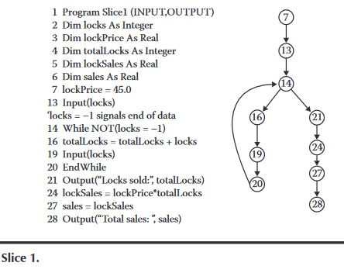
Program Slices

Slide 34
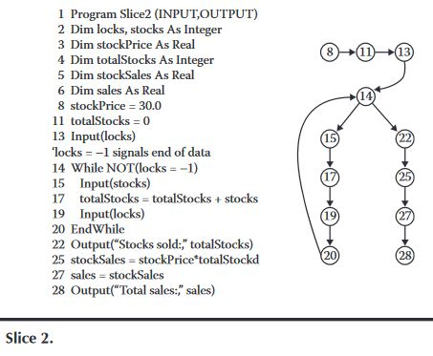
Program Slices

Slide 35
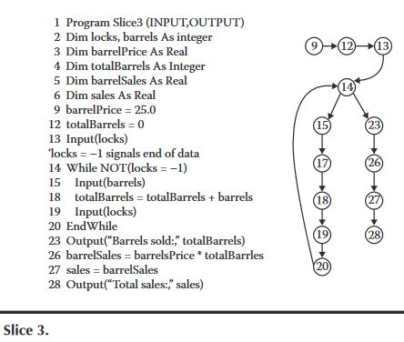
Program Slices

Slide 36
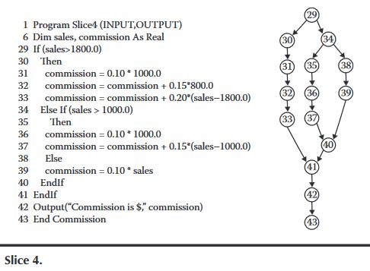
Program Slices

Slide 37
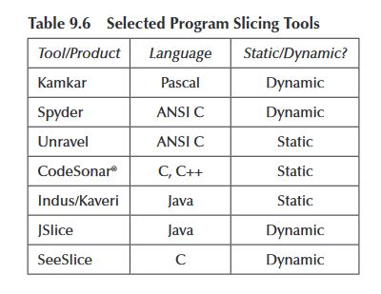
Program Slices

Slide 38
Program Slices: Guidelines and Observations
Slices do not map nicely into test cases as some unrelated code is still in an executable path
Use slice composition approach to re-develop difficult sections of code and test these slices before you splice ( compose) them with other slices.
Relative complement of slices (A-B) yield a diagnostic capability.
Ex: S(Commission,41)={7,8,9,10,11,12,13,14,15,16,17,18,19,20,24,25,26,27,29,30,31,32,33,34,35,36,37,38,39}
S(sales,27)={ 7,8,9,10,11,12,13,14,15,16,17,18,19,20, 24,25,26,27 }
S(Commission,41)-S(sales,27)= { 29,30,31,32,33,34,35,36,37,38,39 }
A many-to-many relationship exists between slices and DD-paths: statement in one slice may be in several DD-paths, and statements in one DD-path may be in several slices.
Slices exhibit define/reference information. Consider the following slices on totalLocks:
Ex: S9: S(totalLocks,10)={10}
S10: S(totalLocks,16)={10,13,14,16,19,20}
S11: S(totalLocks,21)={10,13,14,16,19,20}
When Slices are equal, the corresponding paths are definition-clear.

